Slide 1
Knowledge graph-based data mining for interdisciplinarity analysis on SDG research,
Ashika Gade
11550648

Slide 2
Research Question:
•How effective are different bibliometric indicators (e.g., citations, co-authorship networks) in assessing the impact and reach of research on specific SDGs, and how do these indicators vary across disciplines and regions?

Slide 3
explanation:
Citations are a widely used bibliometric indicator of the impact and reach of research. They measure the number of times a paper has been cited by other papers, which is taken as a proxy for its influence. However, citations can be biased in favor of papers published in high-impact journals and authored by well-known researchers.
Co-authorship networks can be used to identify collaborators and research clusters. This information can be used to assess the reach and impact of research by identifying the diversity of researchers and institutions involved in a particular research topic. However, co-authorship networks can be complex and difficult to interpret.

Slide 4
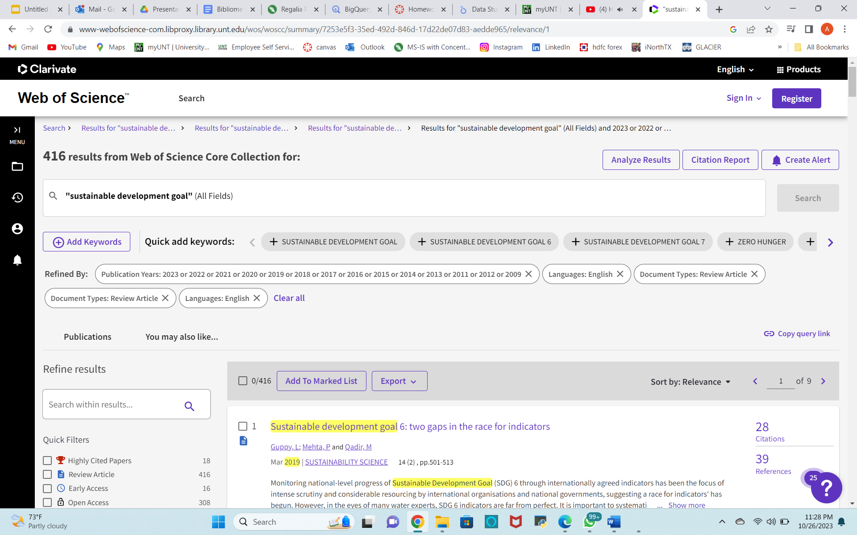
Boolean search:

Slide 5
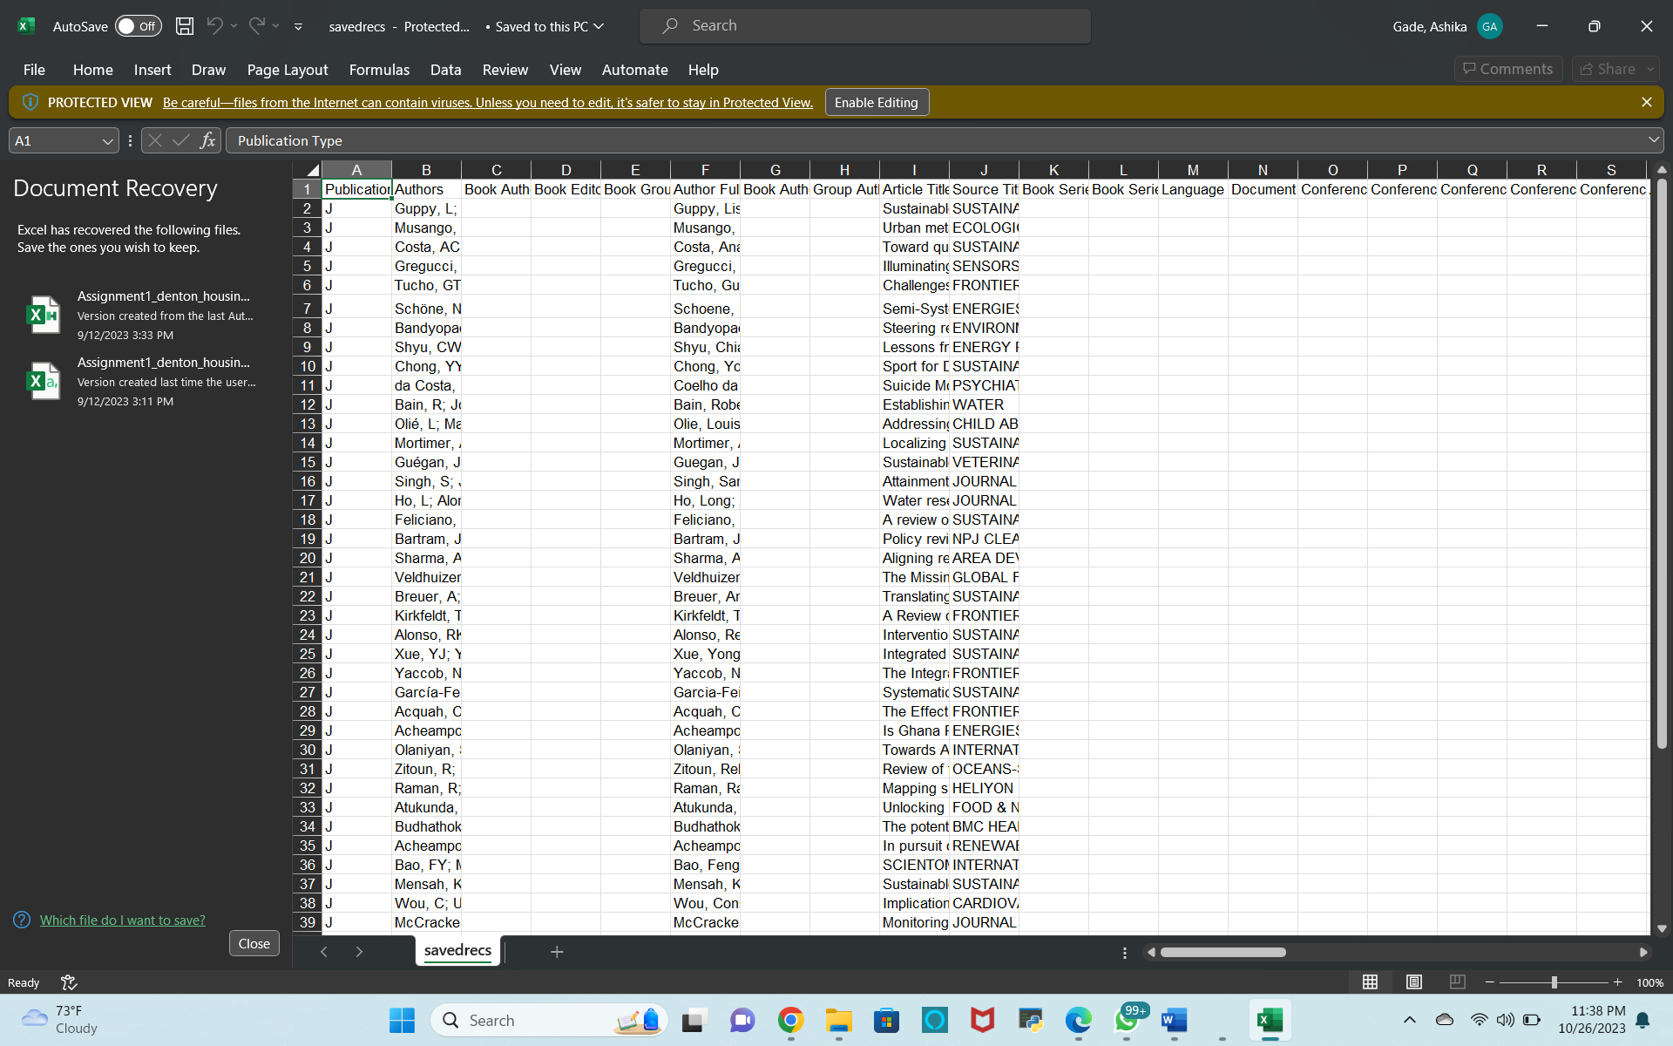

Slide 6
Other tools for connectivity:
Flowcharts: Flowcharts are diagrams that use shapes and arrows to depict the flow of a process or system. They're great for illustrating sequential steps and decision points.
Venn Diagrams: Venn diagrams are used to illustrate the relationships and commonalities between different sets or categories. They are useful for showing overlapping or intersecting areas.
Conceptual Maps: Conceptual maps are used in education and research to illustrate the relationships between ideas or concepts in a more free-form manner.
Entity-Relationship Diagrams (ERD): ERDs are used in database design to illustrate the relationships between tables and data entities. They help to define the structure of a database.
Network Diagrams: Network diagrams are commonly used in IT and project management to represent the relationships between various components in a network or project. Tools like Visio or Lucidchart are popular for creating these.

Slide 7
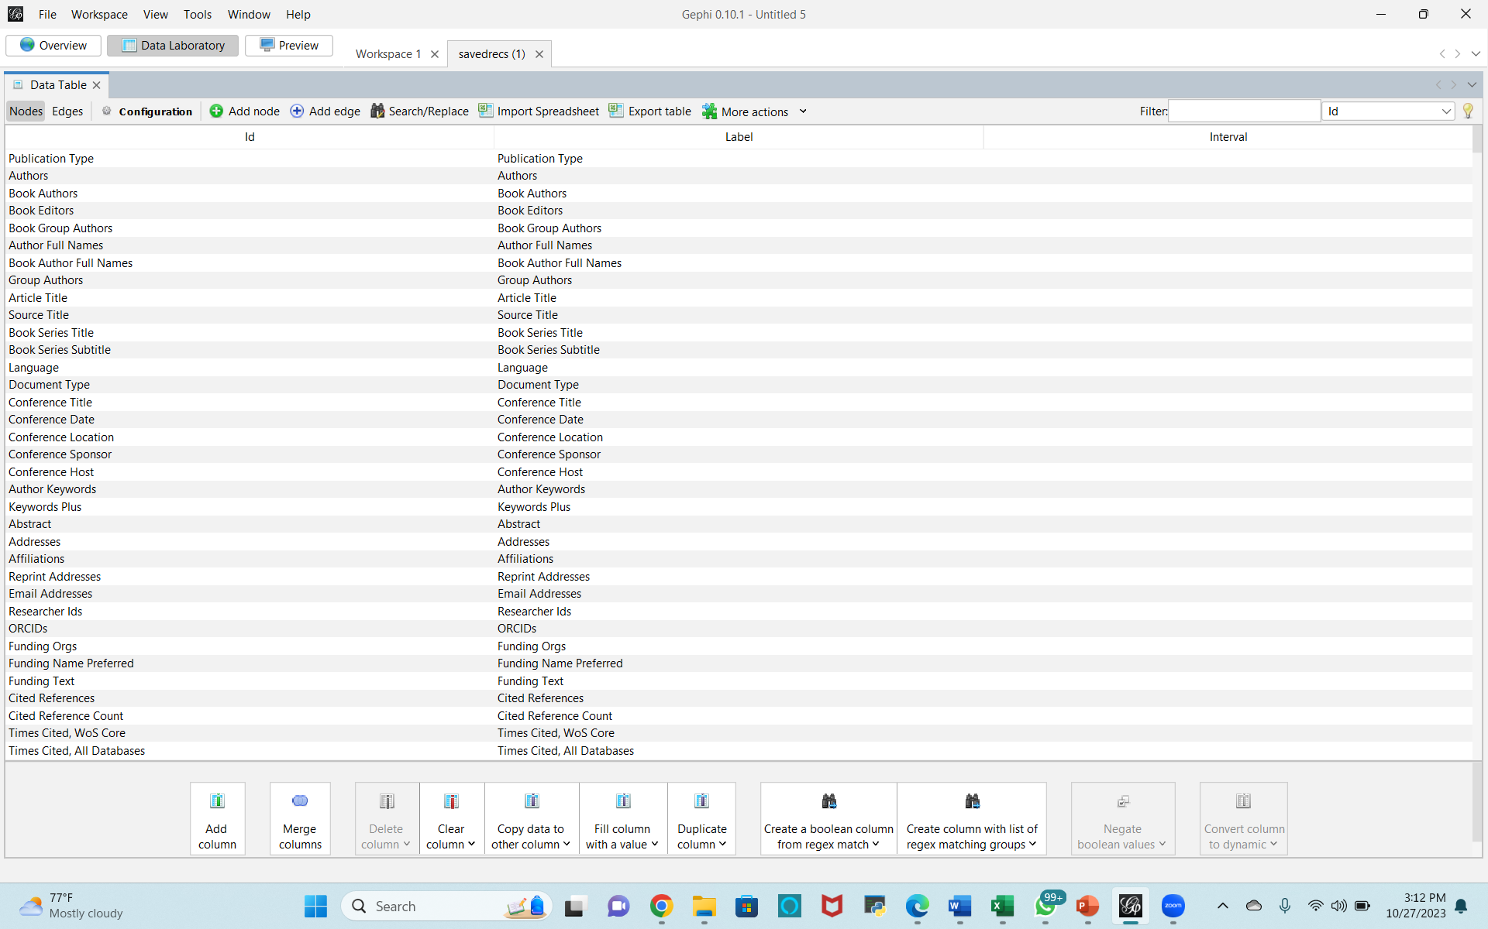

Slide 8
